Slide 1
Box^3
Sharron Butler
Daniel Pendleton
Aaron Ratcliffe
Brian Hamilton
Samuel Ansin

Slide 2
The Game
Monsters
Mazes
Survivors
Boxes

Slide 3
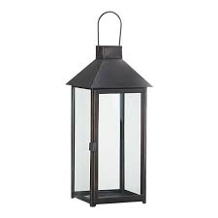
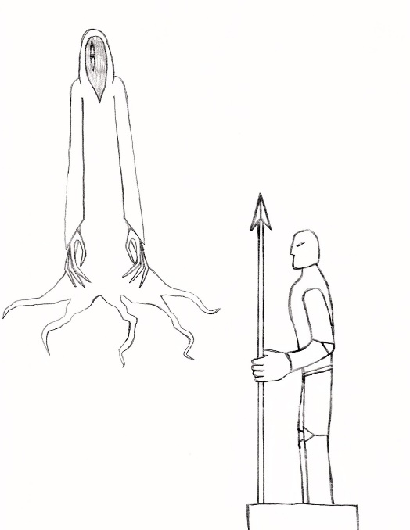
Atmosphere
Low light
Confusion
Being chased

Slide 4
Game maker
Easy of use
Still Supported

Slide 5
Schedule

